Slide 1


Design Thinking & Innovation
Empathy Talk Presentation
TEAM
FACULTY MENTOR
Team Name / Batch No: Team Aqua
Year & Dept / Section: II Year-CyberSecurity
Members:
1. Nishanth - 25SY042
2. Sridharan - 25SY050
Name: Mrs.B.Suchitra
Designation: Assistant Proffesor
Department: Cyber Secyrity

Slide 2
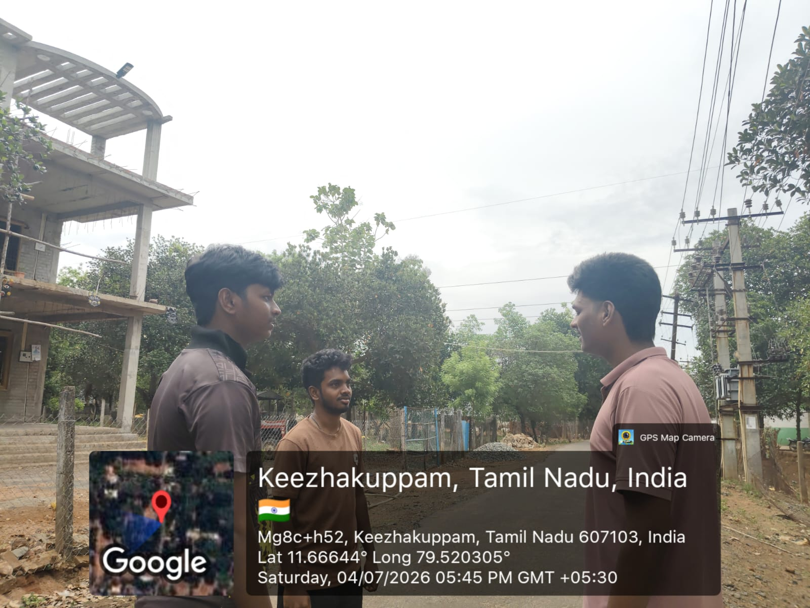


Meet Our User
Who are they?
A daily commuter who drives to shopping malls, hospitals, colleges, airports, railway stations and office buildings.
Role / Occupation: Working professional / daily driver
Age group: 25 - 45 years
Location: Urban area with crowded parking facilities
Where we met them: Shopping mall parking lot during peak hours
Lives in the city; drives daily to work, malls, hospitals and other crowded places.
Add a photo or sketch of your user
In their words
"I circled the parking lot three times and still couldn’t find an empty slot — I was already late."
Sri Eshwar College of Engineering · Design Thinking & Innovation

Slide 3



How We Built Empathy
What to do: In each step, write what YOUR team actually did to understand your user. A sample is shown in grey — replace it with your own.
1
2
3
Observe
Interact
Understand
Watch them in their real setting. What do they struggle with — without saying a word?
Talk and listen. Ask “why” until you reach the real reason.
Step into their shoes. Separate what they say from what they truly need.
OUR FINDING
OUR FINDING
OUR FINDING
We observed drivers circling repeatedly around mall and hospital parking lots during peak hours, wasting several minutes searching for a vacant slot.
We asked drivers and parking attendants why parking took so long; they said there was no way to know which slots were free before entering.
Their real need isn’t more parking space — it’s real-time information about vacant slots so they don’t waste time, fuel, or get frustrated.
Sri Eshwar College of Engineering · Design Thinking & Innovation

Slide 4

User Interview
Play the recorded interview with your user during the presentation.
Paste your video link or Google Drive link of the video you captured in the user interview.
What we learned
Drivers spend several minutes searching for parking in crowded areas like malls, hospitals, colleges and offices, causing traffic congestion, fuel wastage and frustration; manual monitoring gives no real-time availability information.
What surprised us
Click to play
We were surprised how much time and fuel is wasted daily over something as simple as not knowing which slots are vacant, and how stressful this becomes during peak hours.
🔗 Video link: [ paste YouTube / Google Drive link here ]
Sri Eshwar College of Engineering · Design Thinking & Innovation

Slide 5
Empathy Map Canvas
Designed for: Drivers/commuters looking for parking
Designed by: [ Team Aqua ]
Date: 06 July 2026
Version: V1.0
GOAL
1
WHO are we empathizing with?
2
What do they need to DO?
Drivers and commuters trying to park in crowded malls, hospitals, colleges, airports, railway stations and office buildings.
They need to quickly find and reach a vacant parking slot without wasting time, fuel or getting stuck in traffic.
3
What do they SEE?
4
What do they SAY?
5
What do they DO?
Long queues of vehicles, full parking lots, no display board of vacant slots, other drivers also circling and getting frustrated.
“I’ve been circling for 10 minutes.” “Is there space inside?” “Why isn’t there a display board?”
Circle the parking area multiple times, ask security guards for directions, or park in wrong/restricted spots out of frustration.
6
What do they HEAR?
7
What do they THINK and FEEL?
Friends and colleagues complain about parking hassles at the same locations; guards give vague directions.
PAINS Frustration, stress, wasted time and fuel, fear of being late.
GAINS Quick, guided, real-time parking information and a smooth, hassle-free entry.
▶ Present your completed Empathy Map to reviewers — fill the canvas above, or paste a photo of your team's map here in this slide.

Slide 6

Insights & Pain Points
Read your map again — the gap between what the user SAYS and what they FEEL is where the insight hides.
Top 3 Pain Points
Key Insight
1
Wasted time & fuel
The one thing we now understand about our user that we didn't before:
Drivers spend several minutes circling crowded parking areas searching for a vacant slot.
Drivers don’t just need more parking space — they need real-time visibility into which slots are free so they can park without wasting time, fuel, or getting frustrated.
2
No real-time availability
No real-time information is available about slot occupancy before entering the parking area.
3
Inefficient manual monitoring
This surprised us: How something as simple as not knowing slot availability causes real traffic congestion, pollution and frustration.
Manual monitoring by staff is slow and leads to poor utilization of available parking space.
Sri Eshwar College of Engineering · Design Thinking & Innovation

Slide 7
Problem Statement Canvas
Year & Dept/Section:II Year-Cyber Secyrity Team / Batch No: TeamAqua Members: Nishanth. K , Sridharan. R
TARGET USER Who is facing the problem? (age group / role / location): 18-50/drivers/ Urban area with crowded parking facilities
CONTEXT
PROBLEM
ALTERNATIVES
Occurs during peak hours in crowded parking areas of malls, colleges, hospitals, airports, railway stations and office buildings.
Traditional parking systems rely on manual monitoring and give no real-time information about vacant slots, causing inefficient use of space.
Drivers circle around the parking lot manually searching for a spot, or ask security guards/attendants for directions.
CUSTOMERS
EMOTIONAL IMPACT
ALTERNATIVE SHORTCOMINGS
Daily commuters, visitors and vehicle owners who frequently park at crowded public and commercial buildings.
Frustration, stress and anxiety about being late, along with fatigue from repeatedly circling the parking area.
Manual searching and asking attendants is slow and unreliable, and does not prevent unnecessary delays or fuel wastage.
QUANTIFIABLE IMPACT
Several minutes wasted per visit searching for parking, leading to increased fuel consumption, traffic congestion and air pollution.
▶ Present your completed Problem Statement Canvas to your reviewers.

Slide 8

Our Problem Statement
FINAL PROBLEM STATEMENT
[ Drivers/commuters ] needs a way to [ know parking slot availability in real time before entering crowded areas ] because [ manual monitoring wastes time and fuel, and increases traffic congestion and pollution ].
HOW MIGHT WE (HMW) — turn the problem into an opportunity
How might we help [ drivers ] to [ quickly find and access a vacant parking slot ] so that [ time, fuel and frustration are reduced and parking space utilization improves ] ?
Sri Eshwar College of Engineering · Design Thinking & Innovation

Slide 9

Mapping to the UN SDGs
Which UN Sustainable Development Goal(s) does solving your problem help advance?
1
2
3
4
5
6
No Poverty
Zero Hunger
Good Health
Quality Education
Gender Equality
Clean Water
7
8
9
10
11
12
Clean Energy
Decent Work
Industry & Innovation
Reduced Inequalities
Sustainable Cities
Responsible Consumption
13
14
15
16
17
Climate Action
Life Below Water
Life on Land
Peace & Justice
Partnerships
Our problem maps to SDG [ 11 ] because it reduces traffic congestion, fuel wastage and air pollution by helping vehicles find parking quickly, making urban mobility and city infrastructure more sustainable and efficient.
Sri Eshwar College of Engineering · Design Thinking & Innovation

Slide 10
Thank You!
Questions, feedback & ideas are always welcome.
Sri Eshwar College of Engineering
Sri Eshwar Innovation Studio · Coimbatore | Tamilnadu

